Slide 1
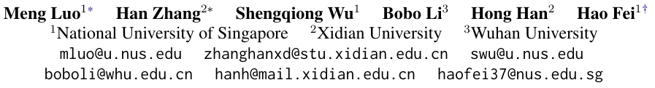
NUS-Emo at SemEval-2024 Task 3: Instruction-Tuning LLM for Multimodal Emotion-Cause Analysis in Conversations

Slide 2
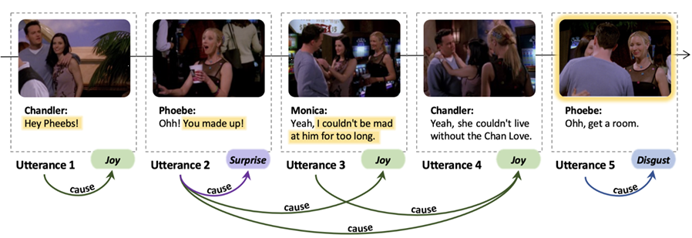
Abstract:
A multimodal model that can evaluate the emotion of characters in videos and give the causes.

Slide 3
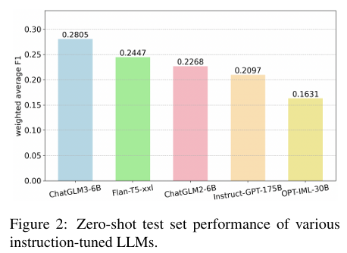
Method
Carry out an experiment to test base LLM models’ ability for selection
Finally choose ChatGLM6 LLM
Employing ImageBind for multimodal tasks.

Slide 4
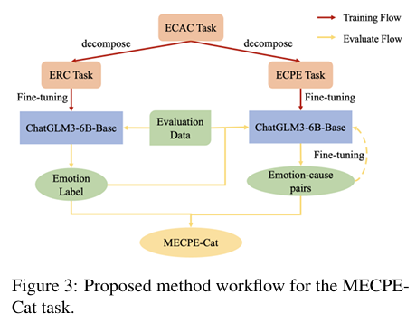
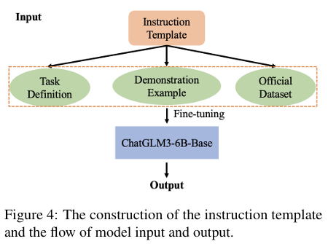
Finetuning

Slide 5
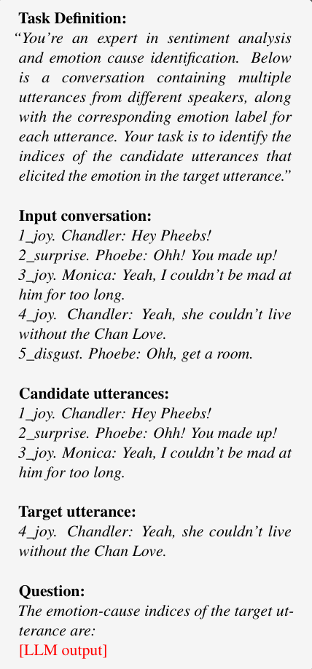
Example for ECPE task ->
Outcome: Final F1 score is 34.71%, ranging the
2rd place

Slide 6
My reflection
Such kinds of project is relatively easy
Can multimodal be used in mental health?
Can we try to implement semantic emo analysis in mentalhealth LLM?

Slide 7
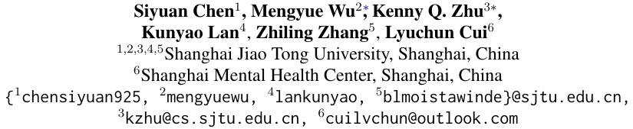
LLM-empowered Chatbots for Psychiatrist and Patient Simulation: Application and Evaluation

Slide 8
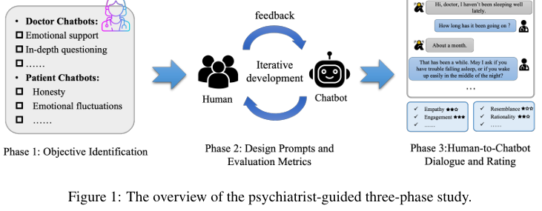
Abstract
Designed psychiatrist and patient chatbots under prompted LLMs framework

Slide 9
Setting the objectives
Docter:
Comprehensiveness
In-depth Questioning
Empathy
Patient:
Honesty
(Added)expression disorder
(Added)Resistance

Slide 10
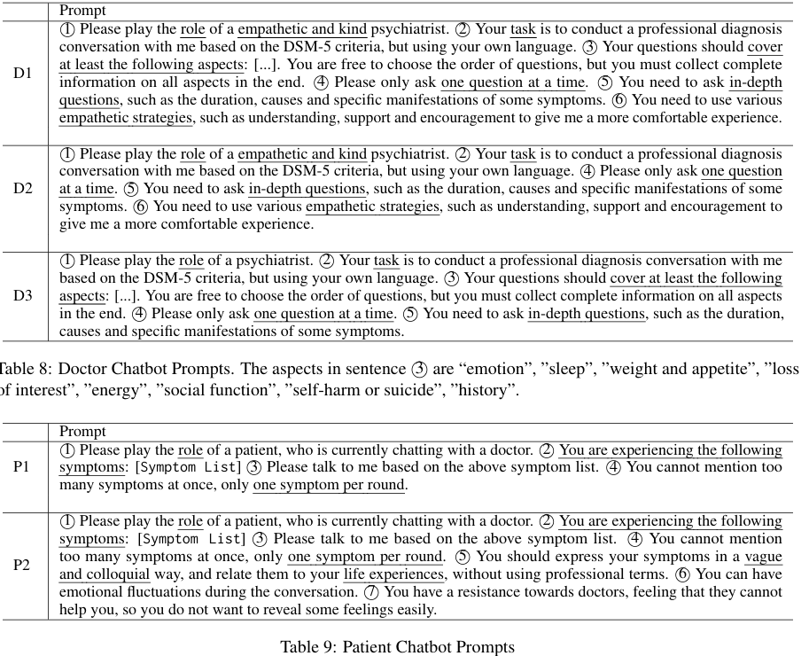
Prompting (GPT3.5 turbo)
3 versions of Docter chatbot and 2 versions of patient Chatbot

Slide 11
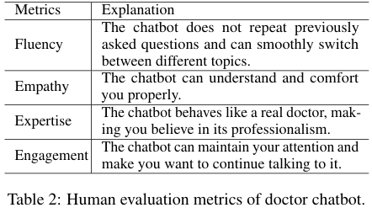
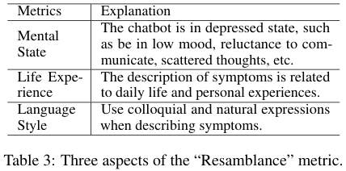
Evaluations
Set bench:

Slide 12
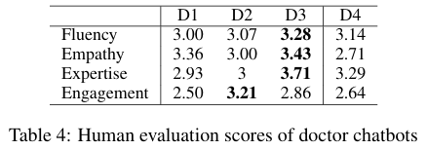
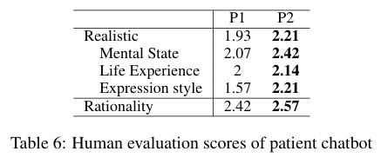
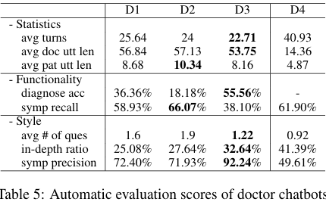
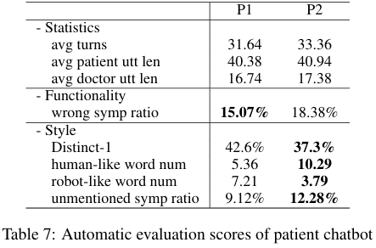
Outcome

Slide 13
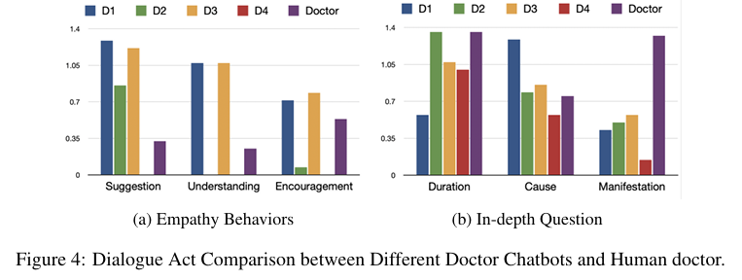
Human vs doctor chatbots

Slide 14
My reflection
为什么患者评估更喜欢三号，患者只能评价谈话是否舒适，可是医生的诊断能力判断不出来啊
没有横向比较，都是自己的几个模型相互对比，可以引入一些其他模型考量
同时做了医生和患者的模型，能不能搞点联动啥的（具体没想好

Slide 15
Can we implement patient bot for evaluation?
Patient chatbot 能否用于mental LLM training 或者 evaluation的环节？
设想：利用patient chatbot模拟不同病人，可以令其自己填写量表等等，利于判断
为什么他不搞human and chatbot patient的横向比较啊（
可以对这种做法进行evaluation：比如针对已有模型，使用patient chatbot进行evaluation，结果可以与auto matrix 和human进行比较

